Slide 1
Microprocessors
A microprocessor requires an external memory for program/data storage.
Instruction execution requires movement of data from the external memory to the microprocessor or vice versa.
Usually, microprocessors have good computing power and they have higher clock speed to facilitate faster computation.

Slide 2
Microcontrollers
A microcontroller has required on-chip memory with associated peripherals. A microcontroller can be thought of a microprocessor with inbuilt peripherals.
Microcontroller maybe called computer on chip since it has basic features of microprocessor(like ALU, registers, flags, program counter, stack pointer, clock and interrupt circuit)

Slide 3
A microcontroller does not require much additional interfacing ICs for operation and it functions as a stand alone system.
Microcontroller are special purpose devices , while microprocessors are general purpose devices.
There are numerous microcontrollers and many of them are application specific.
Notes:
Real life application microcontrollers examples like car,tv,washin m/c a/c mobile phones etc

Slide 4
MICROCONTROLLER APPLICATIONS
Microcontrollers are used extensively in robotics.
In addition to control applications such as the home monitoring system, microcontrollers are frequently found in embedded applications.
Among the many uses that you can find one or more microcontrollers: automotive applications, appliances (microwave oven, refrigerators, television and VCRs, stereos), automobiles (engine control, diagnostics, climate control).

Slide 5
INTEL 8051 (8 BIT MASK ROM)
Features:
4 KB on chip program memory(internal ROM).
128 bytes on chip data memory(internal RAM).
8 bit CPU (means it can work on only 8 bits of data at a time) with register A and B.
8-bit data bus
Notes:
Mask ROM (MROM) is a type of read-only memory (ROM) whose contents are programmed by the integrated circuit manufacturer (rather than by the user). The main advantage of mask ROM is its cost, mask ROM is significantly cheaper than any other kind of semiconductor memory.

Slide 6
16-bit address bus
Two 16 bit timers (T0 and T1).
Four 8-bit ports(P0-P3) i.e. 32 I/O pins.

Slide 7
16-bit program counter(PC) and data pointer(DPTR) registers.
8 bit Program Status Word(PSW)- the flag register.
8 bit Stack Pointer(SP).
4 register banks.

Slide 8
Typical applications
8051 chips are used in a wide variety of control systems, telecom applications, robotics as well as in the automotive industry , TV, video games, washing machine.

Slide 9
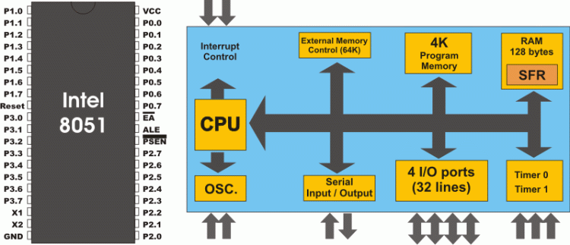

Slide 10
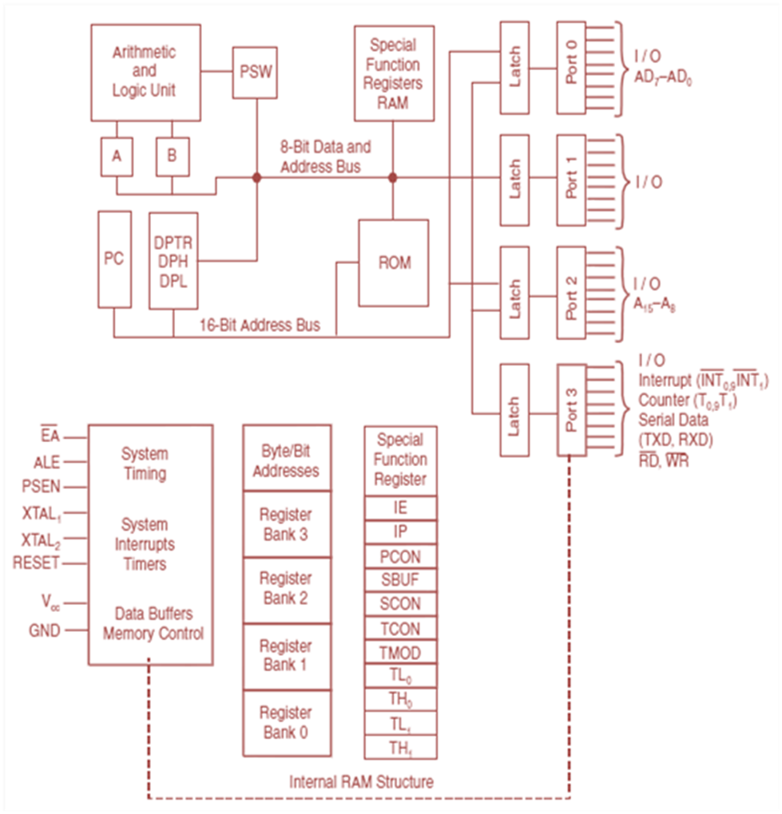

Slide 11
Registers of 8051
Various registers used for specific functions e.g. A,PC etc which are not part of internal RAM.
These registers are known as Special Function Registers (SFR).
These registers maybe addressed using internal addresses range from 80H to FFH except the Program Counter.
The addresses from range 00H to 7FH are used by RAM registers.

Slide 12
Internal Memory (ROM AND RAM)
ROM (4K) is used to store program code for application at time of manufacturing, once written cant be altered.
RAM (128 Byte) used to store variable data during execution of program.

Slide 13
i) Working Registers
With the register banks from locations 00H to 1FH, you may only read or write a full byte (8 bits) at these locations.
Each register can be addressed by name e.g. R5 of bank 2 can be accessed by name R5, after selecting bank 2 by making RS0=0 and RS1=1 in PSW register.
Or it can be addressed by address 15H, whether bank 2 is selected or not.

Slide 14
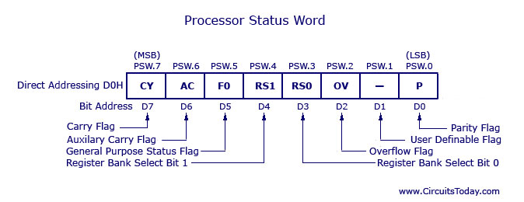
On resetting 8051 , register bank 0 is selected by default.
The D3 and D4 bits of register PSW are often referred to as PSW.3 and PSW.4 since they can be accessed by bit addressable instructions SETB and CLR.
For eg. “SETB PSW.3” will make PSW.3=1 and select bank register 1.

Slide 15
(ii) Bit Addressable Registers (16 Byte)
16 registers of RAM with byte address range 20H to 2FH are bit addressable.
Each bit of these 16 registers(16*8=128 bits) has its own address range from 00H to 7FH.
These addressable bits are useful , when any information represented by a single bit is to be stored.
Notes:
Example where single bit is useful

Slide 16
Because internal RAM has limited space available, so there is no need to use 8-bit register when a single bit solves the purpose.

Slide 17
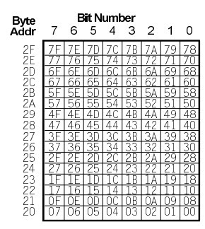
With bit-addressable RAM (20H to 2FH) you can read or write any single bit in this region by using the unique address for that bit.
Fig :-
Bit Addressable
Area

Slide 18
(iii) General Purpose Area (80 Byte)
The area above the bit area, from 30H to 7FH is the general purpose area which is shared with DATA and SFR.
With the general purpose RAM from 30H to 7FH, you may only read or write a full byte (8 bits) at these locations i.e. it is byte addressable.

Slide 19
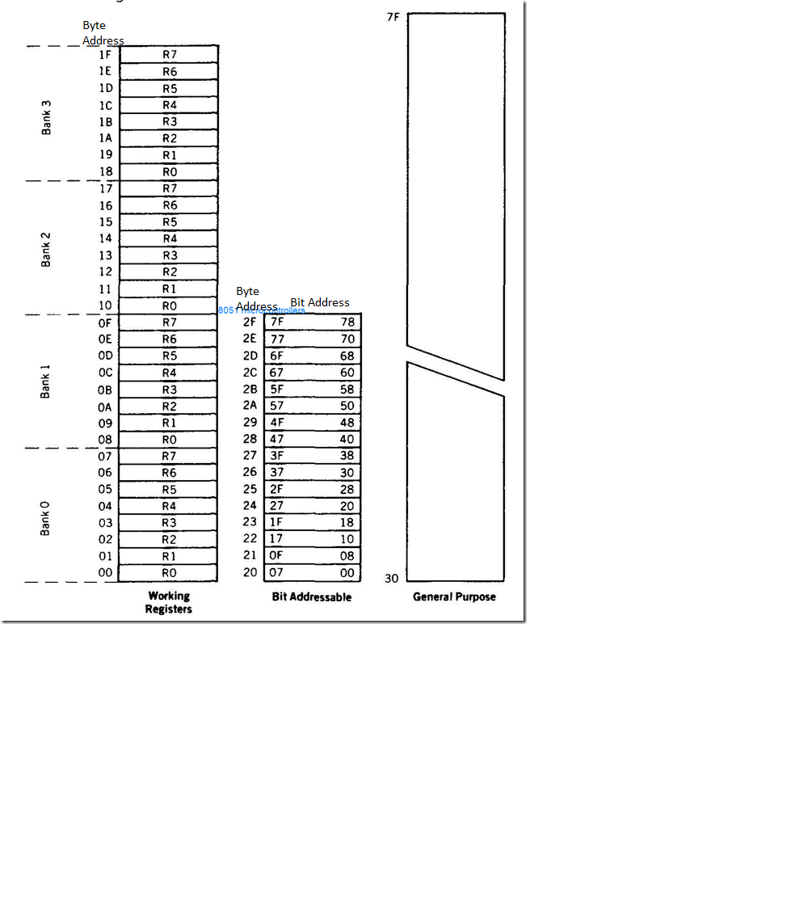
Internal RAM organization

Slide 20
Special Function Register
There are 21 Special function registers (SFR) in 8051 micro controller and this includes Register A, Register B, Processor Status Word (PSW), PCON etc.
There are 21 unique locations for these 21 special function registers and each of these register is of 1 byte size.
Some of these special function registers are bit addressable (which means you can access 8 individual bits inside a single byte), while some others are only byte addressable.

Slide 21
The Special Function Register (SFR) is the upper area of addressable memory, from address 80H to FFH. There are 128 memory locations intended to be occupied by them. A, B, PSW, DPTR are called SFR.
The addresses ranging from 00H to 7FH are used by RAM registers.
This area of memory cannot be used for data or program storage.

Slide 22
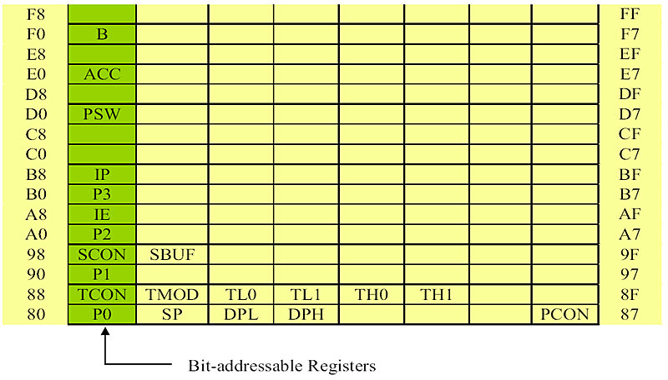

Slide 23
NAME | FUNCTION | INTERNAL RAM ADDRESS
A | ACCUMULATOR | E0H*
B | ARITHMETIC OPERATIONS | F0H*
DPH | ADDRESSING EXTERNAL MEMORY | 83H
DPL | ADDRESSING EXTERNAL MEMORY | 82H
IE | INTERRUPT ENABLE CONTROL | A8H*
IP | INTERRUPT PRIORITY | B8H*
P0 | INPUT/OUTPUT PORT 0 | 80H*
P1 | INPUT/OUTPUT PORT 1 | 90H*
P2 | INPUT/OUTPUT PORT 2 | A0H*

Slide 24
P3 | INPUT/OUTPUT PORT 3 | B0H*
PC | PROGRAM COUNTER | --
PCON | POWER MODE CONTROL | 87H
PSW | PROGRAM STATUS WORD (FLAGS) | D0H*
SCON | SERIAL PORT CONTROL | 98H*
SBUF | SERIAL DATA BUFFER | 99H
SP | STACK POINTER | 81H
TMOD | TIMER/COUNTER MODE CONTROL | 89H
TCON | TIMER/COUNTER CONTROL | 88H*
TL0 | TIMER 0 LOW-BYTE | 8AH
TH0 | TIMER 0 HIGH-BYTE | 8CH
TL1 | TIMER 1 LOW-BYTE | 8BH
TH1 | TIMER 1 HIGH-BYTE | 8DH

Slide 25
A and B Registers
These registers are used to store the result of various arithmetic & logical operations.
The A register is called the accumulator, and by default it receives the result of all arithmetic operations.
It is used for addition, subtraction , multiplication and division etc.

Slide 26
Register A is also used for data transfer b/w microcontroller & external memory.
The B register is used with the accumulator for multiplication & division or to store data and has no other function. In this registers we can store data up to 16 bit.

Slide 27
Processor Status Word (PSW)
This is a vital SFR in the functioning of micro controller. This register reflects the status of the operation that is being carried out in the processor.
PSW register is both bit and byte addressable.
Flags are flip-flops, grouped together inside PSW and Power Mode Control (PCON) registers.

Slide 28
The F0 is a general purpose flag defined by the programmer to record some events in program.
The physical address of PSW starts from D0H. The individual bits are then accessed using D1, D2 … D7.
P the parity flag
The parity flag reflects the number of 1 s in the A (accumulator) register only.
If the A register contains an odd number of Is, then P = 1. Therefore, P = 0 if A has an even number of 1s.

Slide 30
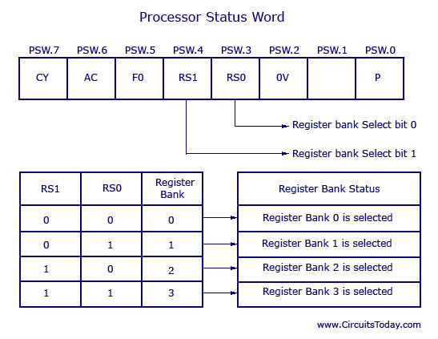

Slide 31
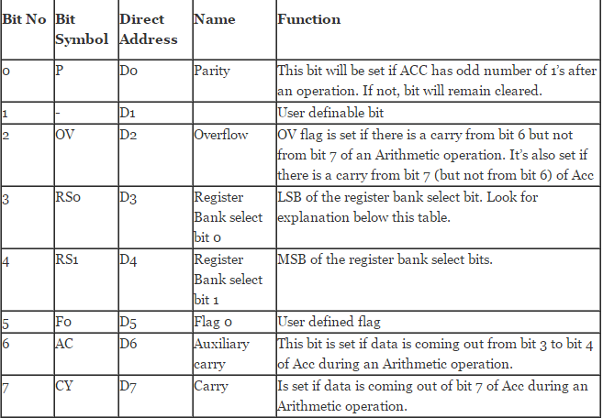

Slide 32
OV the overflow flag
This flag is set whenever the result of a signed number operation is too large, causing the high-order bit to overflow into the sign bit.
In general, the carry flag is used to detect errors in unsigned arithmetic operations.
The overflow flag is only used to detect errors in signed arithmetic operations.

Slide 33
Power Mode control Register (PCON)
Power management using a microcontroller is something you see every day in mobile phones. PCON is not bit addressable.
A mobile phone can automatically go into stand by mode when not used for a couple of seconds, this is achieved by power management feature of the controller used inside that phone.
This register is used for efficient power management of 8051 micro controller. This is a dedicated SFR for power management alone. There are 2 modes for this register :- Idle mode and Power down mode.

Slide 34
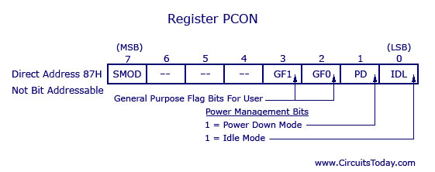
SMOD (D7)- Serial baud rate Modify bit, used in serial I/O, to set different baud rates
Notes:
Baud rate known as the symbol rate, it is measured in symbols per second and symbols are comprised of bits. Baud Rate refers to the number of signal or symbol changes that occur per second. A symbol may have more than two states so it may represent more than one binary bit ( a binary bit always represents exactly two states) . Therefore the baud rate may not equal the bit rate, especially incase of recent modems which can have up to nine bits per symbol.

Slide 35
POWER DOWN MODE:
By setting the PD bit of the PCON register from within the program we can turning off its internal oscillator and reduces power consumption enormously.
The only way to get the micro controller back to normal mode is by reset.
While the microcontroller is in Power Down mode, the state of all SFR registers and I/O ports remains unchanged.
By setting it back into the normal mode, the contents of the SFR register is lost, but the content of internal RAM is saved.

Slide 36
IDLE MODE:
Upon the IDL bit of the PCON register is set, the microcontroller turns off the greatest power consumer- CPU unit while peripheral units such as serial port, timers and interrupt system continue operating normally.
In Idle mode, the state of all registers and I/O ports remains unchanged.
In order to exit the Idle mode and make the microcontroller operate normally, it is necessary to enable and execute any interrupt or reset.

Slide 37
Program Counter
It is a 16 bit register, used to hold the address of program instruction byte to be fetched from the memory and executed. The ROM may be:
On-chip ROM, memory address range from 0000H to 0FFFH.
ii. Additional external ROM , for address exceeding 0FFFH up to FFFFH.

Slide 38
iii. Totally external ROM , address range from 0000H to FFFFH.
PC is automatically incremented after every instruction byte is fetched . It is the only register which does not have an internal address.

Slide 39
Data Pointer(DPTR)
It is made up of two 8-bit registers DPH and DPL used to provide memory address for (i) internal and external code access and (ii) external data access.
The DPTR register is the only user accessible register it is used to point to data, often used to point to data in external memory.
The 8 bit registers DPH and DPL are assigned internal addresses, but the whole 16-bit register DPTR doesn’t have a single internal address.
Notes:
When 8051 accesses external memory it will access external Memory at the address indicated by DPTR.

Slide 40
Stack Pointer(SP)
Stack is an area of internal RAM that is used to store and retrieve data during execution of program.
Stack pointer is an 8 bit register used to store 8 bit address of one of the locations in RAM, called the top of stack.
It is a byte addressable register, which means you cant access individual bits of stack pointer.

Slide 41
The Stack & Stack Pointer can be used in same way as for 8085 microprocessor using PUSH and POP instructions.
The content of the stack pointer points to the last stored location of system stack.
To store something new in system stack , the SP must be incremented by 1 first and then execute the “store” command.

Slide 42
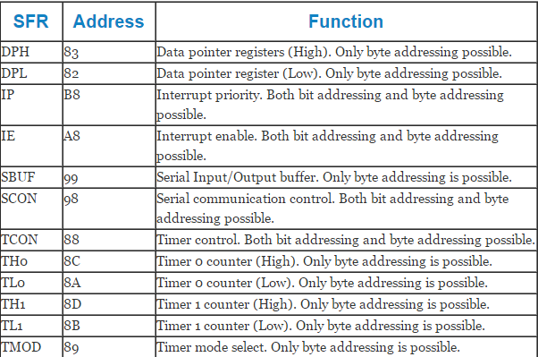

Slide 43
SCON
(Serial Control, Addresses 98h, Bit-Addressable): SCON controls Data Communication. The Serial Control SFR is used to configure the behavior of the 8051's on-board serial port.
This SFR controls the baud rate of the serial port, whether the serial port is activated to receive data, and also contains flags that are set when a byte is successfully sent or received.

Slide 44
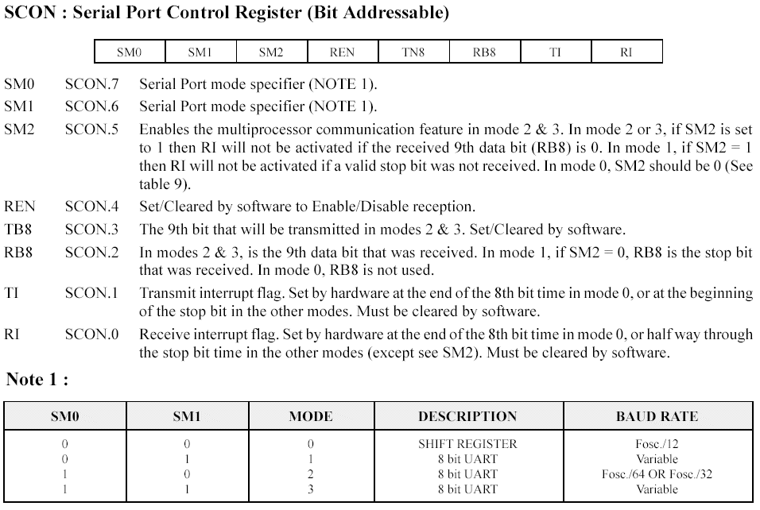
Notes:
UART –universal asynchronous receiver transmitter
Synchronous-transfer block of data (characters) at a time , used for block oriented (multiple bytes) transmissions.
Asynchronous- transfer a single byte at a time, used for character oriented (one byte) transmissions.

Slide 45
SM0 & SM1 :- The four modes are defined above . Selecting the Serial Mode selects the mode of operation (8-bit/9-bit, UART or Shift Register) and also determines how the baud rate will be calculated. In modes 0 and 2 the baud rate is fixed based on the oscillators frequency. In modes 1 and 3 the baud rate is variable based on how often Timer 1 overflows.
SM2:- It is a flag for "Multiprocessor communication." However, when SM2 is set the "RI" flag will only be triggered if the 9th bit received was a "1". That is to say, if SM2 is set and a byte is received whose 9th bit is clear, the RI flag will never be set. This can be useful in certain advanced serial applications.
Notes:
RI :- Generally, whenever a byte has been received the 8051 will set the "RI" (Receive Interrupt) flag. This lets the program know that a byte has been received and that it needs to be processed.

Slide 46
REN is "Receiver Enable." If you want to receive data via the serial port, set this bit.
TB8 :- This bit is used in modes 2 and 3. In modes 2 and 3, a total of nine data bits are transmitted. The first 8 data bits are the 8 bits of the main value, and the ninth bit is taken from TB8. If TB8 is set and a value is written to the serial port, the data bits will be written to the serial line followed by a "set" ninth bit. If TB8 is clear the ninth bit will be "clear.“
Notes:
The last four bits (bits 0 through 3) in SCON are operational bits. They are used when actually sending and receiving data--they are not used to configure the serial port.

Slide 47
The RB8 also operates in modes 2 and 3 and functions essentially the same way as TB8, but on the reception side. When a byte is received in modes 2 or 3, a total of nine bits are received. In this case, the first eight bits received are the data of the serial byte received and the value of the ninth bit received will be placed in RB8.
TI :- It means "Transmit Interrupt.“When the TI bit is set, the program may assume that the serial port is "free" and ready to send the next byte.
RI :- It means "Receive Interrupt."It functions similarly to the "TI" bit, but it indicates that a byte has been received.
Notes:
TI :-When a program writes a value to the serial port, a certain amount of time will pass before the individual bits of the byte are "clocked out" the serial port. If the program were to write another byte to the serial port before the first byte was completely output, the data being sent would be garbled. Thus, the 8051 lets the program know that it has "clocked out" the last byte by setting the TI bit.
RI :-Whenever the 8051 has received a complete byte it will trigger the RI bit to let the program know that it needs to read the value quickly, before another byte is read.

Slide 48
Interrupt Enable Register
→ We can configure the 8051 so that any of the following events will cause an interrupt:
Timer 0 Overflow.
Timer 1 Overflow.
Reception/Transmission of Serial Character.
External Event 0.
External Event 1.
Your program may enable and disable interrupts by modifying the IE SFR (A8h)

Slide 49
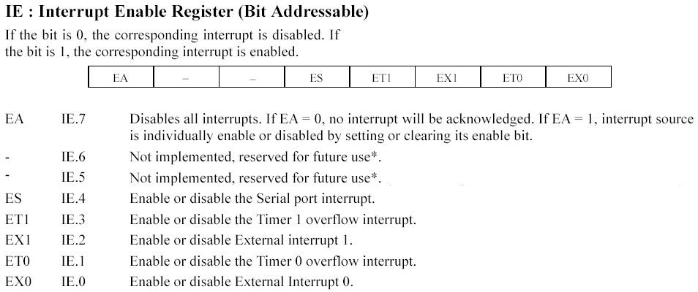
Notes:
Serial port interrupt :- if a data byte is received RI is set to 1 in the SCON register . When a data byte has been transmitted an interrupt bit, TI is set in SCON . These are ORed to provide a single interrupt to the processor; serial port interrupt.

Slide 50
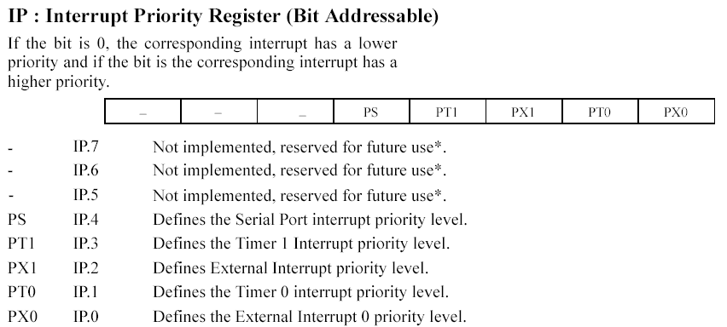
Interrupt Priority

Slide 51
Interrupts with high priority can interrupt another interrupt with a low priority; lower priority interrupt continues after higher is finished.
If 2 interrupts with same priority occur at same time then they have the following ranking :-
1. IE0
2. TF0
3.IE1
4.TF1
5. SERIAL=RI OR TI

Slide 52
SBUF
SBUF is physically two registers . One is write only and is used to hold data to be transmitted out of 8051 via TxD . Any value written to SBUF will be sent out the serial port's TXD pin.
The other is read only and holds received data from external sources via RxD . any value which the 8051 receives via the serial port's RXD pin will be delivered to the user program via SBUF.
Likewise, In other words, SBUF serves as the output port when written to and as an input port when read from.

Slide 53
PORTS
There are four 8-bit ports: P0, P1, P2 and P3.
PORT P1 (Pins 1 to 8): The port P1 is a general purpose input/output port which can be used for a variety of interfacing tasks. The other ports P0, P2 and P3 have dual roles or additional functions.
PORT P3 (Pins 10 to 17): Port P3 acts as a normal I/O port, but Port P3 has additional functions such as, serial transmit and receive pins, 2 external interrupt pins, 2 external counter inputs, read and write pins for memory access.

Slide 54
PORT P2 (Pins 21 to 28): PORT P2 can also be used as a general purpose 8 bit port when no external memory is present, but if external memory access is required then PORT P2 will act as an address bus in conjunction with PORT P0 to access external memory. PORT P2 acts as A8-A15.
PORT P0 (Pins 32 to 39): PORT P0 can be used as a general purpose 8 bit port when no external memory is present, but if external memory access is required then PORT P0 acts as a multiplexed address and data bus that can be used to access external memory in conjunction with PORT P2. P0 acts as AD0-AD7.

Slide 55
Timers/Counters Programming
Many microcontroller applications require counting of external events such as generation of precise internal time delays b/w computer actions.
To relieve the processor of this burden two 16 bit up counters named T0 and T1 are provided for the general use of the programmer.

Slide 56
They can be used as :-
The timer to generate time delay.
The counters T0 and T1 maybe programmed to count internal clock pulse to work as timer.
An event counter.
To count external clock pulses to work as counter.
These clock pulses could represent the number of wheel rotations, or any other event that can be converted to pulses.
Notes:
These tasks like counting time delays can be accomplished using software techniques, but s/w loops for counting or timing keep the processor occupied so that other perhaps more important functions are not done.

Slide 57
Registers
The counters are divided into two 8-bit registers , TL for Timer Low and TH for Timer High :-
TH0, TL0 : timer/counter register of timer 0
TH1, TL1 : timer/counter register of timer 1

Slide 58
Two Special function Registers TMOD and TCON are used to control the counter action of these counters by changing their bit status using certain instructions.
TMOD : Mode Select register
TCON : Control Register

Slide 59
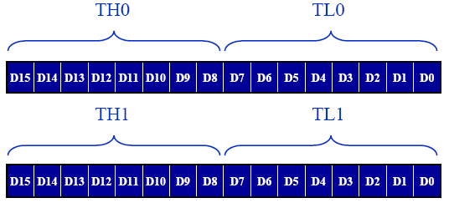
Timer0 and Timer1 Registers
Accessed as lower byte and higher byte
The lower byte register is TL0 / TL1
The higher byte register is TH0 / TH1
Accessed like any other register
MOV TL0, #4Fh :- this command moves the value 4Fh into the TL0 SFR.

Slide 60
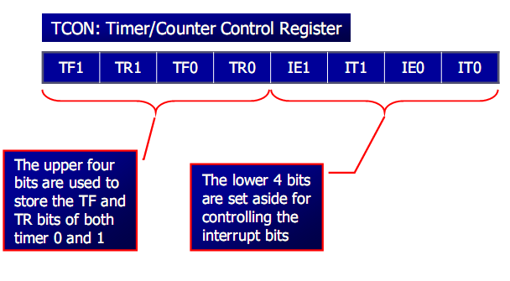
TIMER CONTROL (TCON) register

Slide 61
TCON register is also one of the registers whose bits are directly in control of timer operation.
Only 4 bits of this register are used for this purpose, while rest of them is used for interrupt control. Bit addressable as TCON.0 to TCON.7.

Slide 62
Timer control and Flag bits
TR (Timer run control bit)
TR0 for Timer/counter 0; TR1 for Timer/counter 1.
TR is set by programmer to turn timer/counter on/off.
TF (Timer flag bit)
TF0 for timer/counter 0; TF1 for timer/counter 1.
TF is like a carry. Originally TF=0. When TH-TL rolls over from FFFFH to 0000, the 8051 sets TF to 1.

Slide 63
TF1:- Timer1 Overflow flag. Set when timer rolls from all 1s to 0.Cleared when processor executes routine ISR.
TR1:- Timer1 Run control bit. Set to 1 to enable timer to count; cleared to 0 by program to halt timer.
TF0:- Timer0 Overflow Flag. Set when timer rolls from all 1s to 0.Cleared when processor executes routine ISR.
IE1 :- External Interrupt 1 Edge flag . Set to 1 when a high to low edge signal is received on port 3 pin 3.3 (INT1). Not related to timer operations.

Slide 64
IT0 :- External Interrupt 0 signal type control bit. Set to 1 by program to enable external interrupt 0 to be triggered by a falling edge signal. Set to 0 by program to enable a low level signal on external interrupt 0 to generate an interrupt.
IE0 :- External Interrupt 0 Edge flag. Set to 1 when a high to low edge signal is received on port 3 pin 3.2 (INT0). Not related to timer operations.
IT1 :- External Interrupt 1 signal type control bit. Set to 1 by program to enable external interrupt 1 to be triggered by a falling edge signal. Set to 0 by program to enable a low level signal on external interrupt 1 to generate a interrupt.

Slide 65
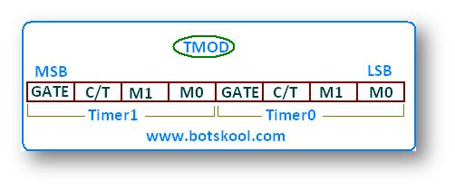
TIMER MODE CONTROL(TMOD) REGISTER
TMOD is not bit addressable.

Slide 66
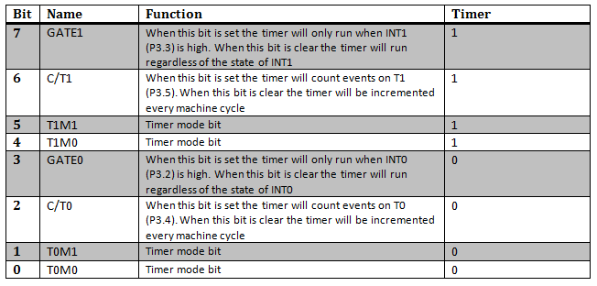

Slide 67


Slide 68
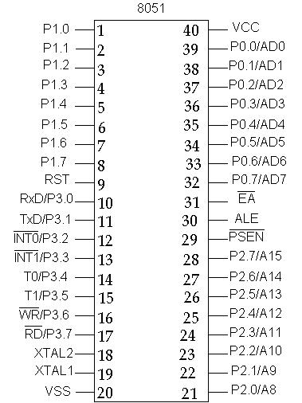
PIN DIAGRAM

Slide 69
BASIC PINS
PINS 1 TO 8 (P1.0 to P1.7) : This is PORT 1 , it is 8-bit bi-directional I/O port. It is bit/byte addressable. When logic '1' is written into port latch then it works as input mode. It functions as simply I/O port and it does not have any alternative function.
PIN 9 (RST) : PIN 9 is the reset pin which is used to reset the microcontroller’s internal registers and ports upon starting up.

Slide 70
PIN 10 TO 17 (P3.0 to P3.7) : This is PORT 3, these Pins are similar to Pins of Port 1. These Pins can be used as universal Input or output. These are dual function Pins.
PIN 10 (RxD/P3.0) : It is an Input signal. Through this I/P signal microcontroller receives serial data of serial communication circuit.
PIN 11 (TxD/P3.1) : It is O/P signal of serial port. Through this signal data is transmitted.

Slide 71
PINS 12 & 13 : P3.2 & P3.3 i.e. INT0 & INT1 are external hardware interrupt I/P signals. Through this user, programmer or peripheral interrupts to microcontroller.
PINS 14 & 15 : P3.4 & P3.5 i.e. (T0 & T1) are input signal to internal timer-0 and timer-1 circuit respectively. External clock pulses can connect to timer-0 and timer-1 through these I/P signals.
PIN 16 (WR/P3.6) : It is active low write O/P control signal. During External RAM (Data memory) access it is generated by microcontroller. when WR=0 , then performs write operation.

Slide 72
PIN 17 (RD/P3.7) : It is active low read O/P control signal. During External RAM (Data memory) access it is generated by microcontroller when RD=0 , then performs read operation from external RAM.
PINS 18 & 19 : The 8051 has a built-in oscillator amplifier hence we need to only connect a crystal at these pins to provide clock pulses to the circuit.
PINS 21 TO 28 (P2.0 to P2.7) : This is PORT 2 , it is 8-bit bi-directional I/O port. It is bit/byte addressable. During external memory access it functions as higher order address bus (A8-A15).

Slide 73
PINS 29, 30 & 31 : As described in the features of the 8051, this chip contains a built-in flash memory. In order to program this we need to supply a voltage of +12V at pin 31.
If external memory is connected then PIN 31, also called EA/VPP, should be connected to ground to indicate the presence of external memory.
ii) PIN 30 is called ALE (address latch enable), which is used when multiple memory chips are connected to the controller and only one of them needs to be selected.

Slide 74
iii) PIN 29 is called PSEN. This is "program store enable". In order to use the external memory it is required to provide the low voltage (0) on both PSEN and EA pins.
PINS 32 TO 39 (P0.0 to P0.7) : This is Port 0 , it is 8-bit bi-directional I/O port. It is bit/ byte addressable. During external memory access, it functions as multiplexed data and low-order address bus AD0-AD7.
PINS 40 and 20 : Pins 40 and 20 are VCC and ground respectively. The 8051 chip needs +5V 500mA to function properly.

